Slide 1

CPSC 4820/6820 Game Design Introduction and Overview
Dr. Guo Freeman
School of Computing
Clemson University

Slide 2
Agenda
2:30 – 2:40 Introduction
2:40 – 3:20 Course overview
3:20 – 3:45 Q & A; chat about
games

Slide 3
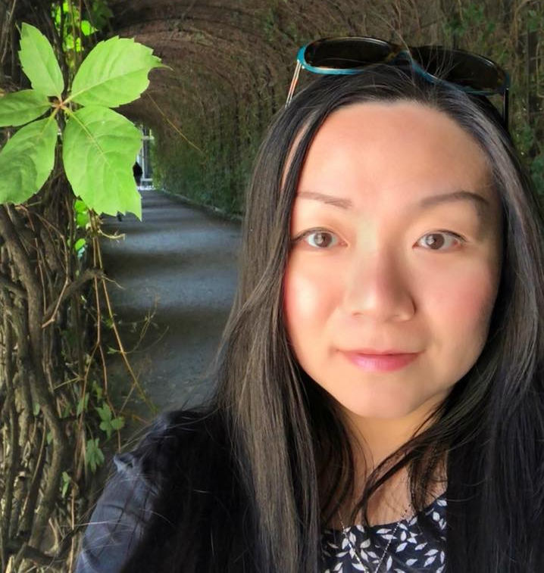
Dr. Guo Freeman
Research areas
Human-Computer Interaction (HCI), Computer Supported Collaborative Work (CSCW), games and virtual worlds
Current research projects relate to:
Indie game development
Live streaming
Social VR
eSports
Assistant Professor, Human-Centered Computing
Director, Gaming and Mediated Experience Lab (CUGAME)
Email: guof@clemson.edu
Office: 204 McAdams
Website: https://guof.people.clemson.edu/

Slide 4
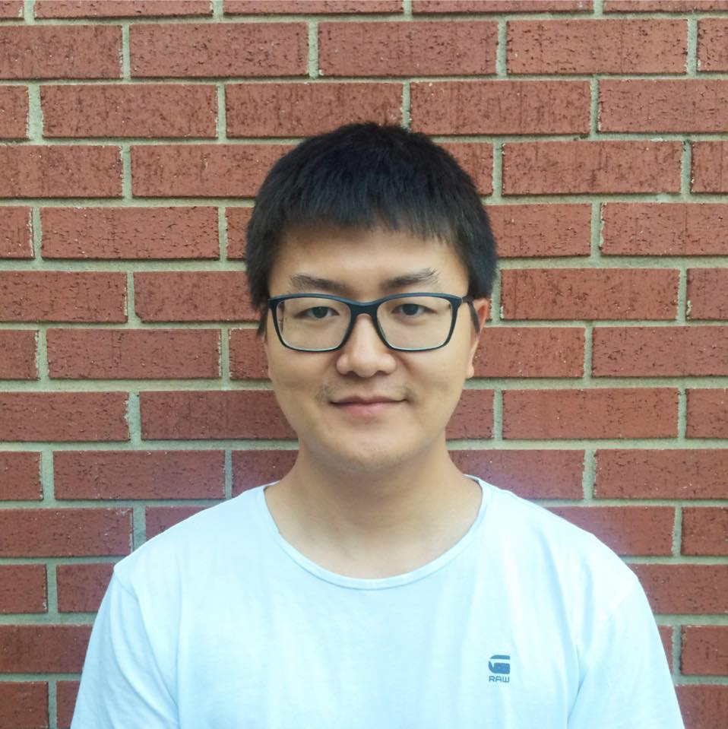
Your TA
Cheng Guo, HCC PhD student
Email: chengg@clemson.edu
Cheng will help grading; he will also come to classes occasionally when he needs to grade your presentations/demos.

Slide 5

Course Overview
What is more fun than playing a game?
Design a game!

Slide 6
Important notes to read before you decide to take this class
This course explores the interdisciplinary nature of games and the fundamentals of game design.
This course covers conceptualization, design, management, and teamwork for a game project as well as learning societal impacts of digital games rather than just programming for a game.

Slide 7
Course content
Main focus
learn principles of game design and social impacts of games through play assignments, in-class teamwork, and group game design exercises.
Some important topics
Types of computer games and players
Psychology of gaming
Prototype and design document
Characters, levels, and gameplay
Narratives and storytelling
Understand the gaming ecosystem and gaming industry
…

Slide 8
After completing this course, you:
will be able to design elements of a game and apply the skills needed to formulate novel game concepts. This will involve:
1) explain the fact that games are not simply software applications but focus on player experience
2) build a solid knowledge on why gameplay and fun is the core of any games other than anything else
3) conduct game design practices as craftsmanship that involves imagining a game, defining how it works, describing the elements that make up that game and successfully communicating or documenting that information to a team, or even yourself, for development.

Slide 9
After completing this course, you (cont.):
4) demonstrate necessary business and management skills for your future workplace, including examining business aspects of the gaming industry that impact design and development, including demographics, economic models, budgets, publishing, and marketing
5) practice using digital prototype to visualize and demonstrate your game ideas.

Slide 10

Textbook
T. Fullerton, Game Design Workshop, 3rd edition, CRC Press, Taylor & Francis Group, 2014, ISBN 978-1-4822-1716-2.

Slide 11
Textbook
Other readings will be available on the Internet or on the Blackboard.

Slide 12
Schedule of Lectures and Readings
Classes will include a mix of lectures, readings, in-class teamwork, and student presentations/demos of their projects.
Usually each Monday students will do presentations or work on their team projects.
Usually each Wednesday we will cover the topic indicated on the schedule
The schedule identifies required readings
All readings are to be completed before the class

Slide 13
How to level up
Brawler (Designing the process)
8/26 – 9/16: psychology of gaming; phases of game development and design document; choose a platform; conceptualization and system design
Warrior (Designing the game world)
9/18 – 10/7: rules and mechanics; characters; levels
Veteran (Designing the player experience)
10/9 – 10/30 : gameplay; narratives and storytelling; interface and audio; design for accessibility
Destroyer (Gaming industry as an ecosystem)
11/4 -- end: understanding the game ecosystem and gaming industry; design for the future

Slide 14
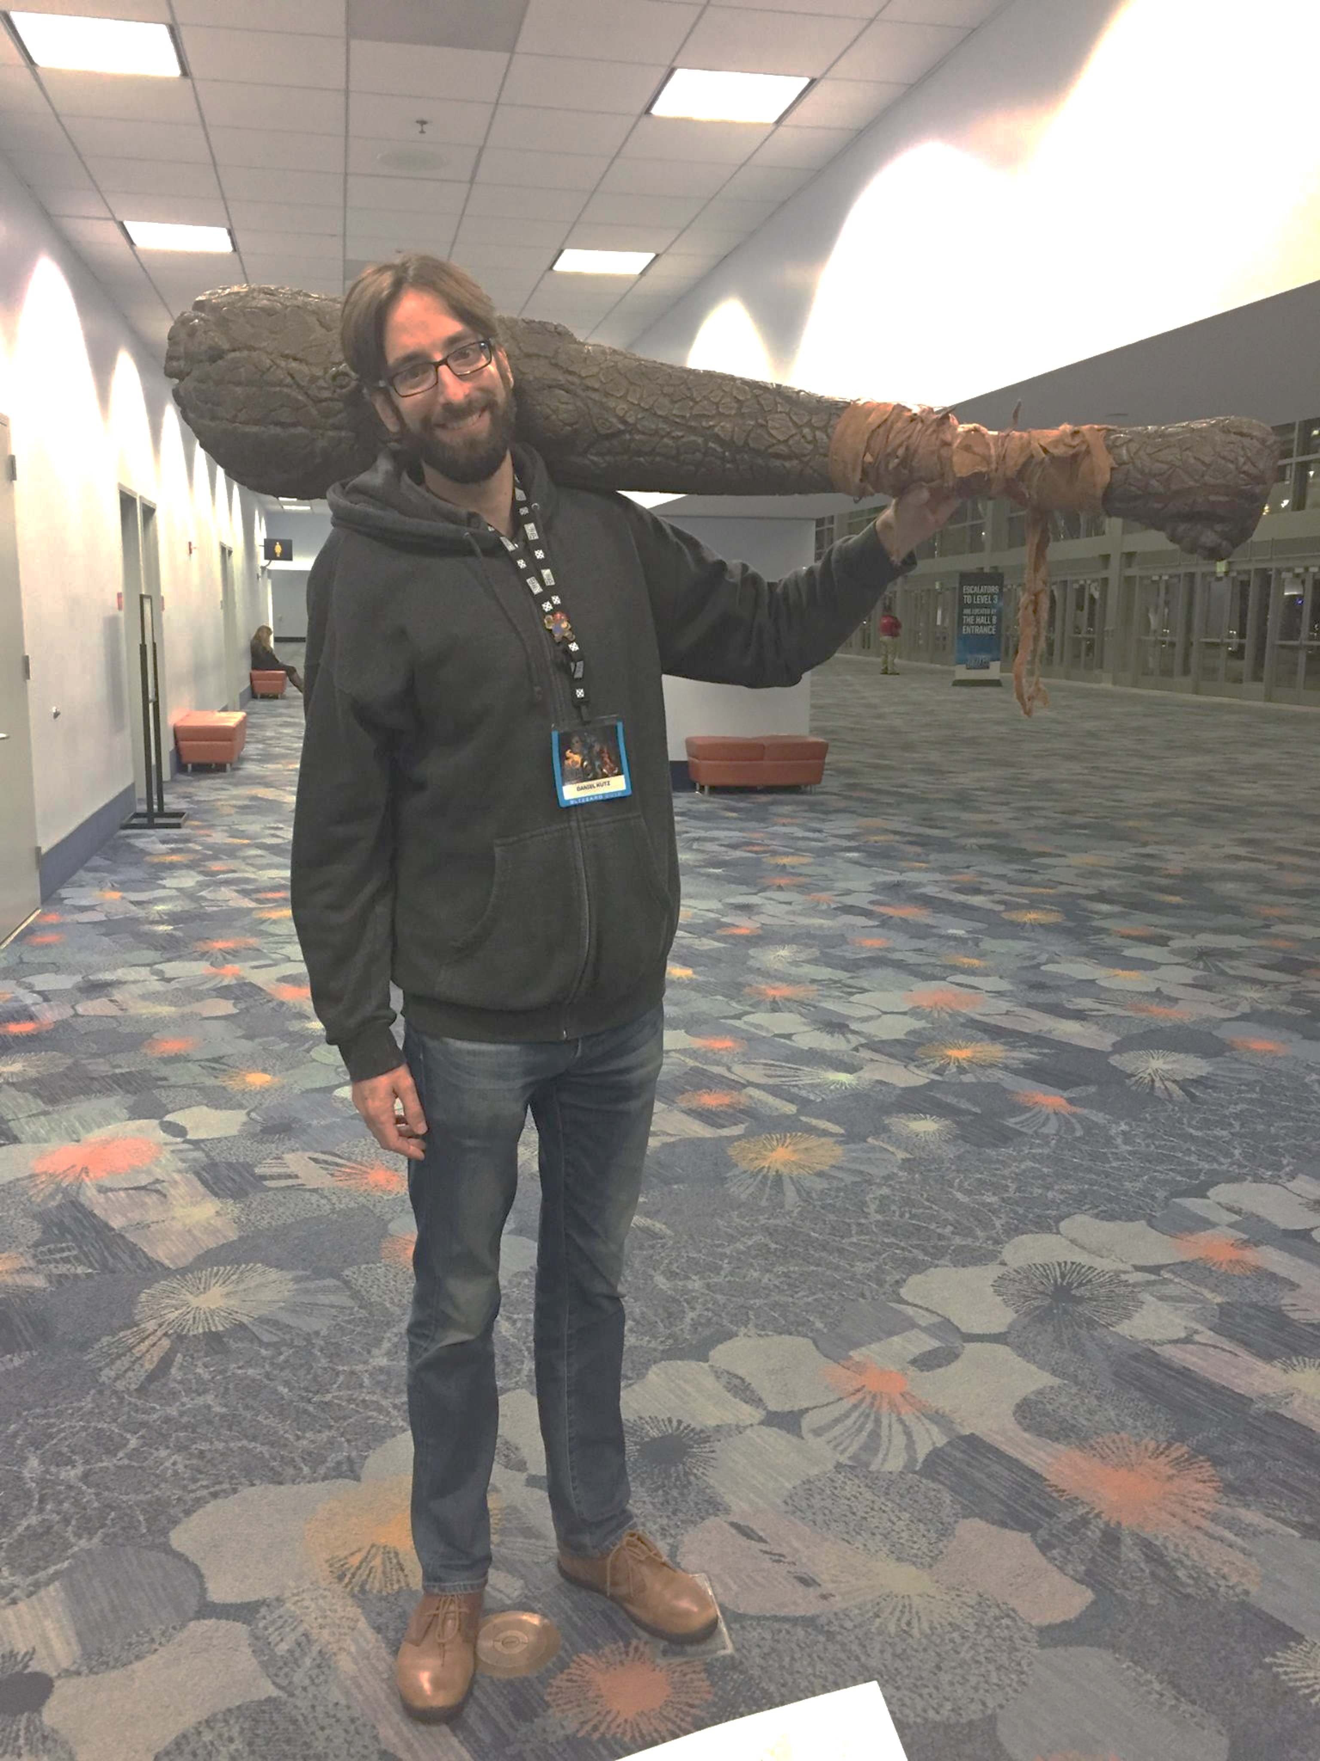

Guest Lecture on 11/20
Daniel Kutz
Lead Senior User Experience Researcher @

Slide 15
Course requirements (See syllabus for details)
For both undergraduates (students who enroll in 4820) and graduate students (students who enroll in 6820), completing required readings, attending classes, actively participating in class discussions, and finishing course projects and presentations on time are essential to doing well in this course.
Undergraduates’ and graduate students’ grades will be based on different criteria.

Slide 16
For undergraduates (students who enroll in 4820):
Participation (individual, 15%)
Play assignments and presentations (Individual, 10%*3)
Team game design project (55%)
You will form small teams (3 to 5 people per team) early in the semester, collectively pitch a game idea to the instructor and to the class, and design the game as a team-based semester-long project.

Slide 17
Participation
15%, individual
This includes completing required readings and attending classes.
This also includes active participation in class discussions (e.g., provide feedback and critiques for others’ presentations both online and in person).
If you miss the class with no explanation more than twice, you will lose all participation points.

Slide 18
Play assignments and presentations (Individual, 10%*3)
This includes completing three play assignments, which are due on 9/2, 9/9, and 9/16.
Each student will present one of his/her play assignments in class (at most 5 mins)
Subject to changes based on time management
For more details: see Discussion on Canvas

Slide 19

Team game design project (55%)

Slide 20
Team game design project (55%)
Game idea pitch presentation (10/7, 10%; team) – I recommend you to start thinking of teammates and game idea as soon as possible though
Early-stage design demo (10/28, 10%; team)
Playable prototype demo (11/18, 10%; team)
“Kickstarter" final presentation (12/2 and 12/4, 10%; team)
Game design document (10%, due 12/11; team)
Retrospective (5%, due 12/11; individual)

Slide 21
Grading policy
90% ~ A
80% ~ 89% B
70% ~ 79% C
60% ~ 69% D
Under 60% F
A = Excellent (Wow!)
B = Good (Hmmmm, Not bad, shows potential)
C = Average (Meh, it’ll pass but….)
D = Below Average (Really?)
F = Fail (What are you doing here?)

Slide 22
For graduate students (students who enroll in 6820):
Participation (individual, 15%)
Team game design project (55%)
You will form small teams (3 to 5 people per team) early in the semester, collectively pitch a game idea to the instructor and to the class, and design the game as a team-based semester-long project.
Submission aiming at the 2020 ACM CHI Student Game Design Competition (team, 30%)

Slide 23
The 2020 ACM CHI Student Game Design Competition
Your team will prepare a submission aiming at the 2020 ACM CHI Student Game Design Competition (https://chi2020.acm.org/authors/student-game-competition/).
The ACM CHI Conference on Human Factors in Computing Systems is the premier international conference of Human-Computer Interaction. The Student Game competition is aimed at providing an opportunity for students from a variety of backgrounds (HCI, computer science, game design, fine arts, etc.) to participate in CHI and demonstrate their game design and development skills in an international competition.

Slide 24
What your submission includes
Your submission will be due by the end of Wednesday, 12/11. It should include three parts:
1. An up to 6 page paper in the ACM extended abstracts format (15%): This paper should include:
An overview of the game itself, and the design and development process, with possibly screenshots/images of play.
The positioning of the game in terms of related work, including references and outlining the game’s unique contribution.

Slide 25
What your submission includes (cont.)
2. A demonstration of the game (this can also be used in your team’s “Kickstarter" final presentation) (10%):
This should take the form of a 4-minute maximum gameplay video clearly showing both the screen (if present) and the player interacting with the game. If the game is not yet fully complete, students could also submit a Wizard of Oz implementation of the game with justification on why the game is incomplete (e.g., technology is not yet there, needs massive resources).
3. A brief video ‘trailer’ (this can also be used in your team’s “Kickstarter" final presentation) (5%) that gives an overview of the game (2 minutes maximum).

Slide 26
Important notes (1)
1. This assignment is part of the course requirements. You do NOT have to actually make the official submission to CHI unless you feel confident/comfortable to do so. The official submission deadline is Jan 6, 2020, 12 pm PST. Please make sure to discuss with me if you do decide to submit to the actual competition. I will provide extra help for finalizing your submission.
If your submission is accepted, it will be published and included in the CHI proceedings (Extended Abstracts); if your game is chosen as one of the five finalists, your team will be invited to attend and demo your game at CHI2020 in Honolulu, Hawaii.

Slide 27
Important notes (2)
2. If you are in a graduate student only team, all team members should contribute to preparing this submission and be co-authors on the paper.

Slide 28
Important notes (3)
3. If you are in an undergraduate-graduate student mixed team, the graduate students should take lead on and be responsible of preparing this submission; undergraduate students are welcome to contribute as much as they want (if so, they should be co-authors or acknowledged, and receive extra course credit).

Slide 29
Important notes (4)
4. This assignment is not required for undergraduate-only team. But they are also welcome to submit to the competition if they want (if so, they will receive extra course credit). Please make sure to discuss with me if you do decide to submit to the actual competition. I will provide extra help for finalizing your submission

Slide 30
Grading policy
93% ~ A
90% ~ 93% A-
85% ~ 89% B+
80% ~ 84% B
75% ~ 79% B-
70% ~ 74% C+
65% ~ 69% C
60% ~ 64% C-
Under 60% F
Or, you could read the grades as:
A and A- = Excellent (Wow!)
B+ and B = Good (Hmmmm, Not bad, shows potential)
B- = Average (Meh, it’ll pass but….)
C+, C, and C- = Below Average (Really?)
F = Fail (What are you doing here?)

Slide 31
Late submission policy
For in-class presentations and demos, no lateness is allowed. You are expected to share your play experience with your classmates or your team is expected to present your game to the class on the due day. If you or your team cannot make an in-class deadline, you may contact me in advance to discuss alternatives or you will receive a grade of zero for that assignment.

Slide 32
Late submission policy (cont.)
For game design document, your retrospective, and the extended abstract, you must contact me in advance if you wish an extension. I can be flexible with many of the written deadlines, but only if you speak to me beforehand. If you do not obtain an extension, the late assignment will be penalized by a third of a grade for every day that it remains overdue.

Slide 33
Attendance policy
You are expected to attend classes!
In the event of an emergency, you should make direct contact with me, preferably before a class or an assignment due. You should discuss with me regarding any scheduled absence as soon as possible and develop a plan for any make-up work. It is the your responsibility to secure documentation of emergencies, if required. If you miss the class with no explanation more than twice, you will lose all the participation points. A student with an excessive number of absences may be withdrawn at the discretion of the course instructor.

Slide 34
Collaboration/Academic Integrity
All members of the team are expected to participate equally in the work of game design, writing, and presentations.
However, groups should be cautious of borrowing their game mechanics too closely from familiar games. This class discourages games that are too similar to existing games such as Scrabble or other popular pastimes.
I’ll let you know if your game is inadvertently plagiarizing in plenty of time to revise it!
Additionally, if your team draws on resources not available to the rest of the class, such as working with other students who are not taking the course, you should clear it with me beforehand and acknowledge your peer in your submission(s).

Slide 35
Important timeline
9/2, 9/9, 9/16: individual presentations in class
9/23: you must have a team by now (preferably earlier)
10/7: game idea pitch
10/28: early stage design demo
11/18: playable prototype demo
12/2 and 12/4: Final presentations
12/11: game design document, retrospective, and submission to CHI2020 student game design competition

Slide 36
Office hours
Dr. Guo Freeman: By appointment via email guof@clemson.edu
Guo Cheng: By appointment via email chengg@clemson.edu
Skype, WebEx
Office: 204 McAdams

Slide 37
Questions?

Slide 38
Announcements
Lecture on both Monday (8/26) and Wednesday (8/28) next week
Read required readings (available on Canvas) prior to the class
Guidelines for Categorization of Games and list of presenters (up to 10 students) will be announced on Monday (8/26)

Slide 39

What is more fun than playing a game? Design a game!

